Slide 2
A modern CMake's CMakeLists.txt is a collection of targets and properties. A target is a job of the building process or, in other words, a desired outcome. In our example, we want to build the source code into a binary executable: that's a target. Targets have properties: for example the source files required to compile the executable, the compiler options, the dependencies and so on. In CMake you define targets and then add the necessary properties to them.
Let's start off by creating the CMakeLists.txt file in the project directory, outside the src/ directory. The folder will look like this:
Notes:
https://www.internalpointers.com/post/modern-cmake-beginner-introduction

Slide 3
Target
Scope: private static share

Slide 4
In our current configuration we have a hardcoded preprocessor definition: USE_NEW_AUDIO_ENGINE. Why not giving users the ability to enable it optionally while invoking CMake? You can do it by adding the option() command anywhere in the CMakeLists.txt file. The syntax is the following:
option(<variable> "<help_text>" [value])
The optional [value] can be ON or OFF. If omitted, OFF is used. This is how it would look like in our dummy project:
option(USE_NEW_AUDIO_ENGINE "Enable new experimental audio engine" OFF)
To use it, just run CMake as follows:
cmake -DUSE_NEW_AUDIO_ENGINE=ON ..
or:
cmake -DUSE_NEW_AUDIO_ENGINE=OFF ..

Slide 5
Dependency Management
Find_library
Find_package
externalProject
FetchContent

Slide 6
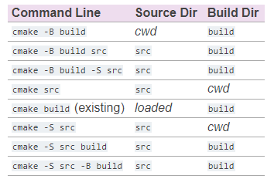
cmake [<options>] -B <path-to-build> [-S <path-to-source>]
Windows: need to specify the generator system
cmake .. –G ``MinGW Makefiles´´

Slide 7
mingw32-make
CMake
Make
.exe
https://cmake.org/cmake/help/latest/manual/cmake.1.html
https://pabloariasal.github.io/2018/02/19/its-time-to-do-cmake-right/?fbclid=IwAR0DsInbCi7rY2xTuzP48kkvvqcTlvCTMjs0sEIgtOQzNdb36_dcm_hteRw

Slide 8
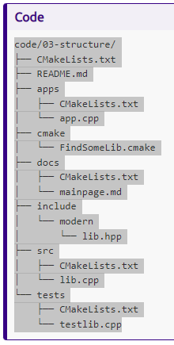
Project Structure
https://hsf-training.github.io/hsf-training-cmake-webpage/06-projectstructure/index.html

Slide 9
https://www.youtube.com/watch?v=bsXLMQ6WgIk&ab_channel=CppNow

Slide 10
Directories
Sub_dir can be added, has their own CMakeLists.txt
Scripts
<script> cmake files that can be executed with cmake –P <script>.cmake
Modules: all scripts files located in the CMAKE_MODULE_PATH.
Notes:
https://www.youtube.com/watch?v=bsXLMQ6WgIk&ab_channel=CppNow

Slide 11
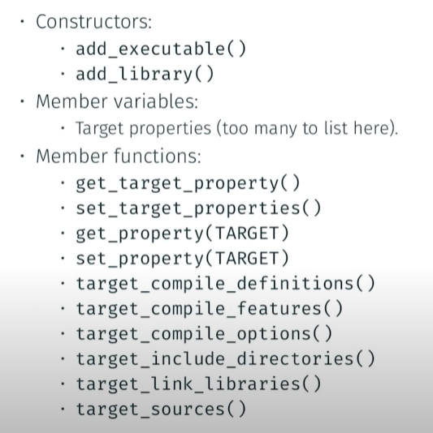
Forget these commands:
Add_compile_options
Include_directory
Link_directories
Link_libraries

Slide 12
Problem with file(GLOB)?#
Get your hands off CMAKE_CXX_FLAGS → not manually configure the flags
https://stackoverflow.com/questions/20746936/what-use-is-find-package-when-you-need-to-specify-cmake-module-path

Slide 13
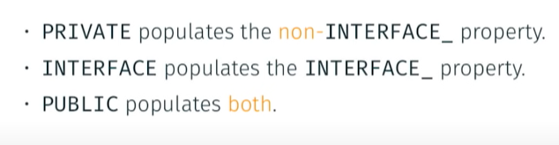
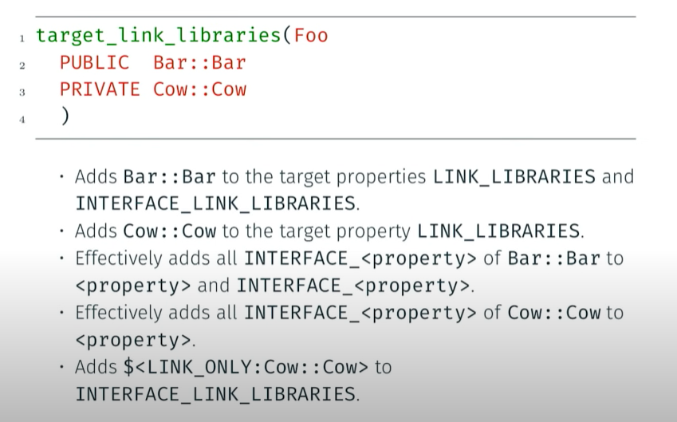
Dependency management

Slide 14
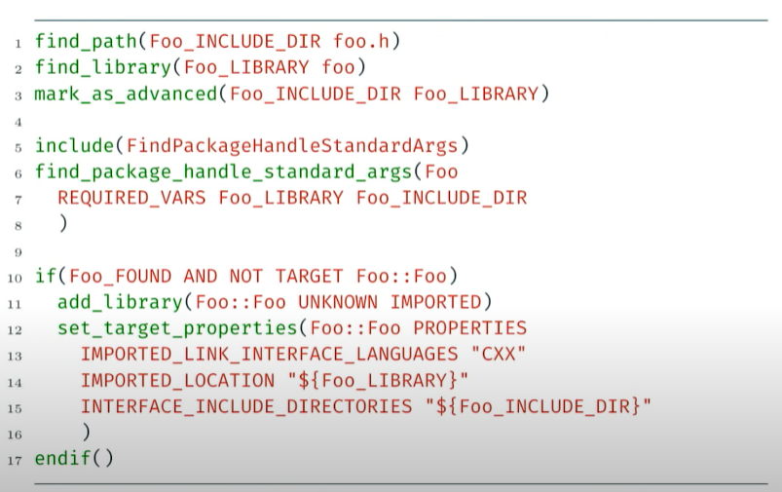
Find a Module
Find package → find_package(Foo) → FindFoo.cmake

Slide 15
Users
Library Provider
Cmake Users
Qt
Boost
Enable cmake users to use
Find_package() (a cmake file provided by the provider)
Find_module() self-made to import that library to our proj

Slide 16
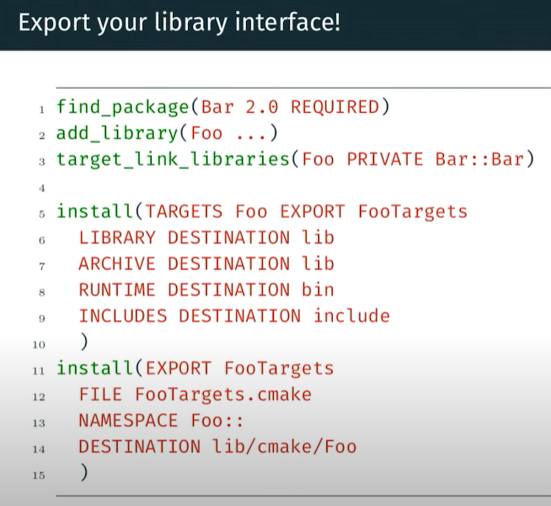

Slide 17
.so
.a
.o
.lib
.dll

Slide 18
Debug
Release
Config

Slide 19
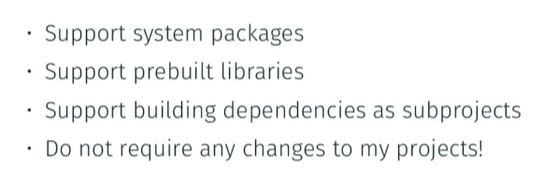
Package Management Requirements

Slide 20
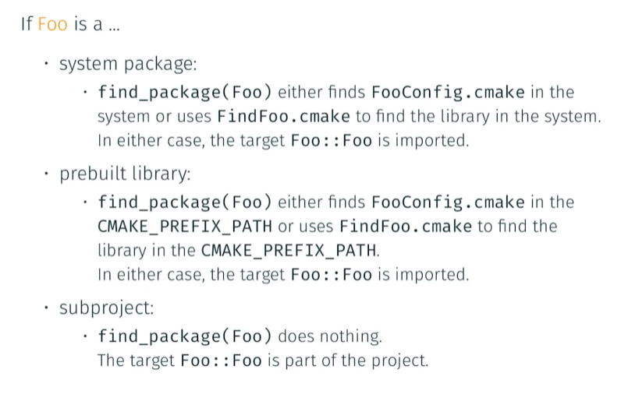

Slide 21
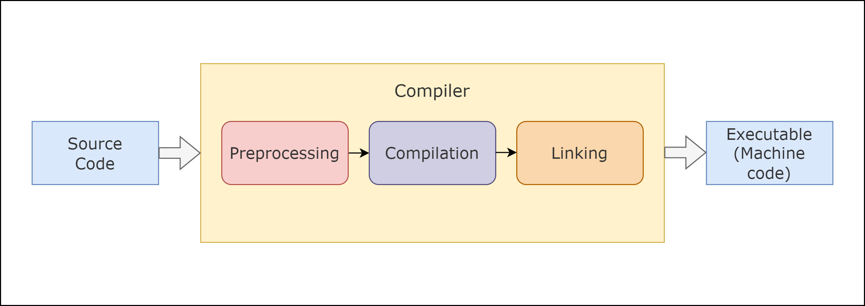
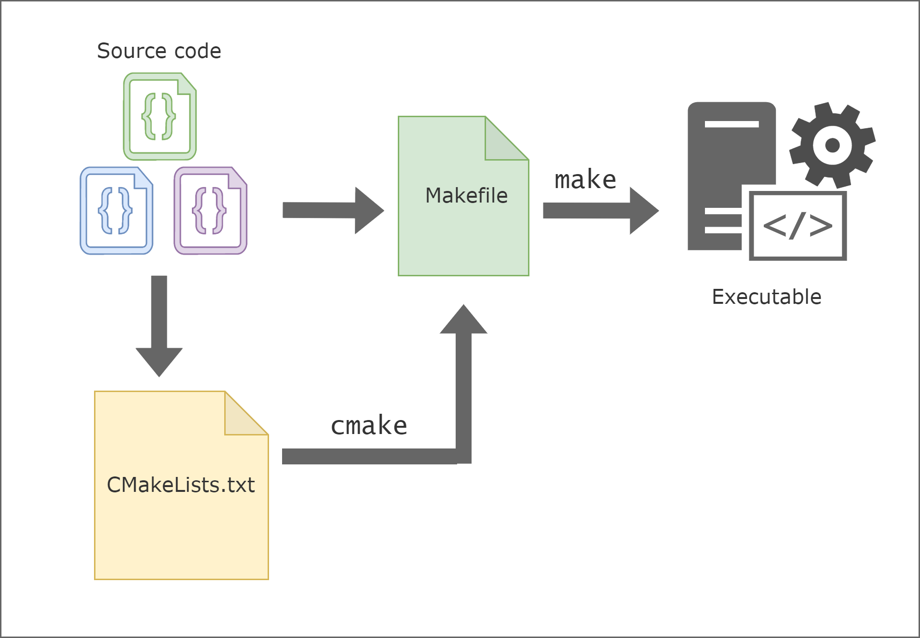
Make is a tool that controls the generation of executables and other non–source files of a program from the program’s source files. It obtains the instructions on how to build the program from a file called the Makefile.
On the other hand, CMake requires a CMakeLists.txt file and is a cross-platform Make. This means that it works on different operating systems. It allows compiler-independent builds, testing, packaging, and installation of software. It’s important to note that CMake produces build files for other systems; however, it’s not a build system itself.

Slide 22
Examples
https://github.com/pr0g/cmake-examples
Project Structure
Dependency Management (find_module, package, fetch, pull …)
Library Export
Testing
Automated Scripts
Guidelines and Principles
Process of cmake

Slide 23
Installing
https://cliutils.gitlab.io/modern-cmake/chapters/install/installing.html
Notes:
https://stackoverflow.com/questions/53121491/what-install-command-does-in-cmake

Slide 24
Some automation
https://bobbelderbos.com/2012/07/simple-bash-script-to-clone-remote-git-repositories/

